Slide 1
Brief Overview of Molecular Simulation Methods
Monte Carlo Simulation (ensemble average – partition function) → NVT (Canonical)
Molecular Dynamics (time average) → NVE (microcanonical)
time average of evolution of system → MD
Ensemble average → MC methods
References:
Understanding Molecular Simulation 2E – Frenkel & Smit
https://www.sciencedirect.com/book/9780122673511/understanding-molecular-simulation (free download with OSU VPN)
2. Computer Simulation of Liquids – Allen & Tildesley
* Note I am using material from different sources so notation will not necessarily match Kusaka book
** some equations and slides are from Prof. S. Shell CHE 201D course in Santa Barbara or from Prof. Hall

Slide 2
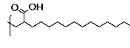
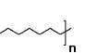
Model to describe molecular interactions
Decide on model
Assume all interactions are pairwise additive, define pairwise potentials (and angle potentials, etc. as needed)
-e.g. all pairs: bonded pairs:
-Lennard-Jones (common) -Harmonic (common)
-For coarse-grained polymers, finitely extensible bonds avoid chain crossing
-set U=0 after some specified cutoff distance where U gets small, this speeds calculation as there will be less pairwise distances and forces to calculate
Coulombic interactions – special algorithms for faster convergence (Ewald summation)
all atoms
-
+
coarse-grained
-
Na⁺
[ ]_{n}

Slide 3
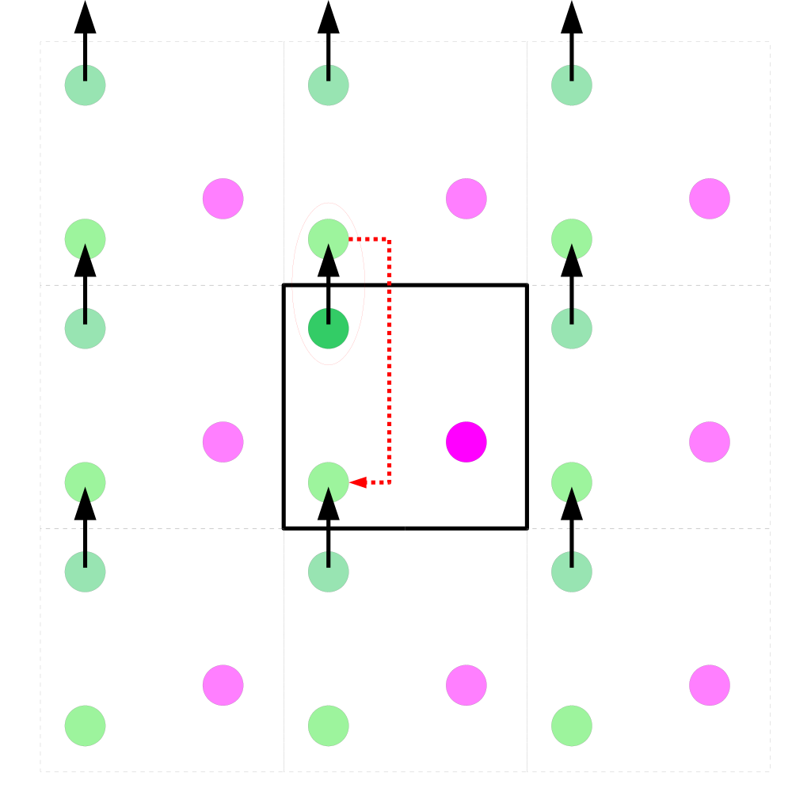
Periodic Boundary Conditions
Relatively simple to implement algorithm
Allows the simulations of extended systems (bulk, surface, 2D films) using systems << 10²³
Care must be taken to test finite size effects – convergence of properties of interest with size

Slide 4
Canonical Ensemble Partition function
Note: Kusaka book this is Z for the classical partition function
Calculate Q → obtain other thermodynamic properties (F, U, Cv, S, P, etc.)
In class, we treat the potential energy term in a simple manner (e.g. 1 particle harmonic spring potential or no potential energy term [ideal gas]).

Slide 5
Canonical Ensemble Partition function
The KE and PE are additive in the Hamiltonian → can be treated independently
Z: Configurational integral – dependent on potential energy terms
Contribution from momenta integral can be calculated analytically
Not practical to evaluate Z or <A> using numerical integration
N = 100,000 → 300,000 dimensional integral

Slide 6
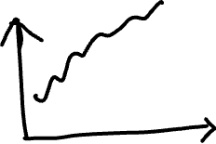
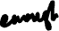
Monte Carlo Approach
Select M random values uniformly over range of x and get an approximation for integral. Requires many points to get accurate value for I.
To more efficiently find <A> use importance sampling based on the Boltzman probability

Slide 7





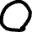

Monte Carlo Approach
Probability of finding system in configuration r^{N}
Select configurations based on the relative Boltzman probability → efficiently obtain <A>

Slide 8



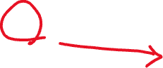


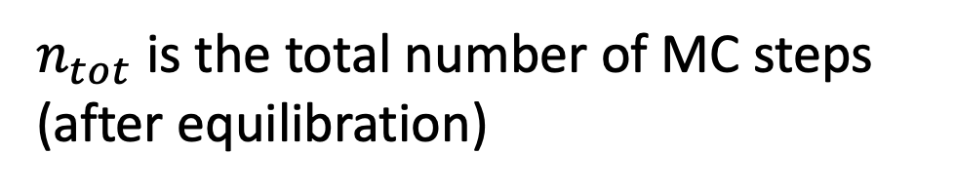
Monte Carlo Approach – Metropolis Algorithm
From State A – select a random change in configuration to state B. (Termed a Monte Carlo Move)
Accept or Reject change based on a criteria that allows the sampling configuration based on the relative Boltzman probability.
The value of <A> will be obtained where the configurations follow the Boltzman probability.
$n_{tot}$ is the total number of MC steps (after equilibration)

Slide 9

Monte Carlo Approach – Metropolis Algorithm
Acceptance criteria must (i) satisfy detailed balance and (ii) the configurations sample the relative Boltzman probability
If new configuration is lower in energy

Slide 10

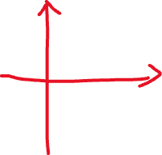


Monte Carlo Approach – Metropolis Algorithm
The evolution of the configurations will follow the relative Boltzman probability

Slide 11

Monte Carlo Approach – Other Ensembles
Grand Canonical Ensemble (μVT)
Exchange particles and energy to keep constant chemical potential and temperature
See Molecular Simulation 2E – Frenkel & Smit for more details on derivation of MC algorithms for different ensembles

Slide 12
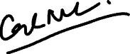
All data below is from GCMC calculations at room temperature.
SWNT data is based on adsorption in close-packed nanotube bundle.
CH₄
H₂
Volumetric adsorption in (10,10) SWNTs is similar to zeolites.
[1] Skoulidas AI, Ackerman DM, Johnson KJ, and Sholl DS Phys. Rev. Let., 89 (2002) 185901

Slide 13
Monte Carlo Approach – Summary
Key concept: Sample the configuration space based on the relative probability distribution appropriate for the ensemble
Walk through configuration space based on a Metropolis algorithm to accept/reject changes. Collect the average of the property of interest.
Advantages (versus MD):
Relatively the same procedure for different ensembles. Can keep variables constant rigorously (e.g. T in NVT ensemble) without more complex techniques required in MD (e.g. thermostat for NVT MD).
Can allow more rapid equilibration (with proper random moves) of complex systems like polymers.
Only requires energies → does not require calculation of forces or velocities.
Not impacted by issues of evolution of equation of motion.
Disadvantages (versus MD):
Move types have to be determined by user (e.g. how big is your atomic displacement).
You do not have velocity and time evolution of structure → cannot access some important information

Slide 14
Molecular Dynamics
Integrate Newton’s laws
Start with all particles’ initial positions and velocities
Step by step calculate forces and update distances
MD is a natural fit for constant NVE system BUT looking at time average instead of statistical ensemble
time average of evolution of system → MD
Ensemble average → MC methods

Slide 15
MD– Numerical Integrating Newton’s Laws
Velocity-Verlet
algorithm:
alone, gives
NVE ensemble
Integrator does not perfectly solve Newton’s laws due to finite time steps and limited accuracy (roundoff error); small error in each timestep accumulates over time
A given initial (p^{f}(t=0), q^{f}(t=0)) theoretically leads to a specific (p^{f}(t), q^{f}(t)), but at long times (p^{f}(t), q^{f}(t)) depends significantly on how integration was done → however, you follow a statistically similar path in phase space (for a good enough integration scheme) leading to the proper statistical properties
Thermostats, barostats can be added to make adjustments (to velocities, volume) during timestepping to keep T, P constant
Now can get a for next step from new positions

Slide 16
MD– Numerical Integrating Newton’s Laws
Formally integrating Newton’s law for N particle system conserves energy → NVE ensemble for a constant volume and N system.
Velocity-Verlet algorithm – one of the most popular MD algorithms
With proper time step and precision can reduce energy drift
Forces on all atoms in the system can be obtained from potential energy evaluation.

Slide 17
MD– Numerical Integrating Newton’s Laws

Slide 18
MD– Numerical Integrating Newton’s Laws
Time step has to be smaller than the smallest motion in your simulation
Initial positions: Select to mimic relevant structure (e.g. condensed matter versus gas)
Initial velocities: Select from Maxwell-Boltzman distribution for velocities based on temperature
Goal: Is to give reasonable initial structure to allow the MD simulation to evolve from → at equilibrium the energy should fluctuate around an average value. Temperature and other properties can be extracted from fluctuation relationships for the microcanonical ensemble (e.g. Cv related to fluctuation of energy).

Slide 19
MD – Equilibration
MD typically started from pseudo-random initial state, not representative of real structure—so must confirm system has been run long enough to equilibrate to true (minimum free energy) structure
If in equilibrium, ensemble average properties do not change with time: anything you measure (temperature, total potential energy, density …) should fluctuate about a constant value rather than drifting over time
Constant properties do not guarantee equilibrium state: system that is “stuck” in a metastable state also will have constant properties over time, and system could potentially be revisiting the same set of states but not exploring other states
In practice, if the system appears to be visiting a variety of configurations and its statistical properties are also constant, it can usually be considered to be in equilibrium
Why would you do a MD simulation instead of a MC simulation?
→ Interested in structure and dynamics of the system (can be compared with experiment)

Slide 20
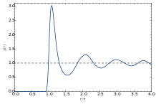
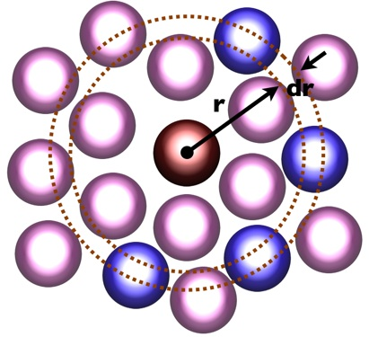
Statistical measure of liquidlike structure: g(r)
Given that a particle of type i is at the origin, g_{ij}(r) gives the probability of a type j particle existing at a distance r, relative to the probability in the bulk
See Journal of Computational Physics 230 (2011) 3566-3569 for details on efficient algorithm for VMD’s calculation of pair correlation function
g_{ij}(r)=(number of times you find i and j atoms at distance between r and r+dr)/
True g(r) is the limit as dr goes to 0. Factor on the bottom is due to volume of shell.
If i=j, the number of pairs is Ni*(Ni-1) (atom does not pair with itself)
Otherwise, the number of pairs is Ni*Nj
Images from Wikipedia: Left by Cri - http://matdl.org/matdlwiki/index.php/Image:Rdf_schematic.jpg, CC BY-SA 3.0, https://commons.wikimedia.org/w/index.php?curid=18997312, Right by Grigory Sarnitskiy (Own work.) [Public domain], via Wikimedia Commons, example g(r) for a LJ fluid at T=0.71, density=0.844 (particles per LJ diameter cubed)
4*pi*r^2*dr*(number of unique i,j pairs in box/volume)

Slide 21
Scattering structure factor S(k)
Based on constructive/destructive interference, if you shine X-rays of a wavelength similar to a sample’s density fluctuations, and measure the intensity of scattered light as a function of angle (related to wavevector k)
Peaks in scattering as a function of k are related to the length scale of density fluctuations
After removing other features such as due to the experimental setup and the shape of the particles that are scattering, the remaining part of the scattering S(k) comes from the particle-particle structure/ordering
While obtaining a full set of atom positions is difficult experimentally, S(k) can be measured and used to compare experimental and MD structure
Can calculate S(k) directly from atom positions, or use a 3D Fourier transform of (g(r)-1). Only certain wavevectors (the k values of S(k)) are appropriate to use in the direct calculation based on the box size; you don’t have information on length scales larger than the box size in each direction, and therefore wavevectors must exactly fit into the box to avoid spurious results. Similarly, when you get S(k) from a Fourier transform of g(r), your lowest wavevector depends on the largest distance in real space you have.
In obtaining g(r) in real space it's hard to fairly count all atoms once, since there are atoms in the corners of the box compared to the center one that are further than L/2, so going just to L/2 then taking the Fourier transform to S(k), in a certain sense you won't get the minimum possible wavevector or include all possible data, but in another sense it's strange to include data past L/2 since the simulation isn't big enough to really capture everything that might be going on at distances over L/2

Slide 22
Scattering structure factor S(k)
See Hansen and McDonald Theory of Simple Liquids p. 78
S(k) for N identical point particles (the brackets imply averaging over many snapshots in time)
The wavevector k relates to the angle and wavelength in a scattering experiment; its units are the inverse of distance units; shorter length fluctuations in density yield a peak at larger k (if particles get closer together, the peak in S(k) moves to higher k)
If you already have g(r), can do a Fourier transform to get S(k) (use number density N/V not mass density)
If isotropic, this can be written as a sine transform
You can’t get information about density fluctuations on length scales larger than the box; if you have m points of g(r) data spaced by dr out to a maximum of L/2, you will get m k values with integer values of n

Slide 23
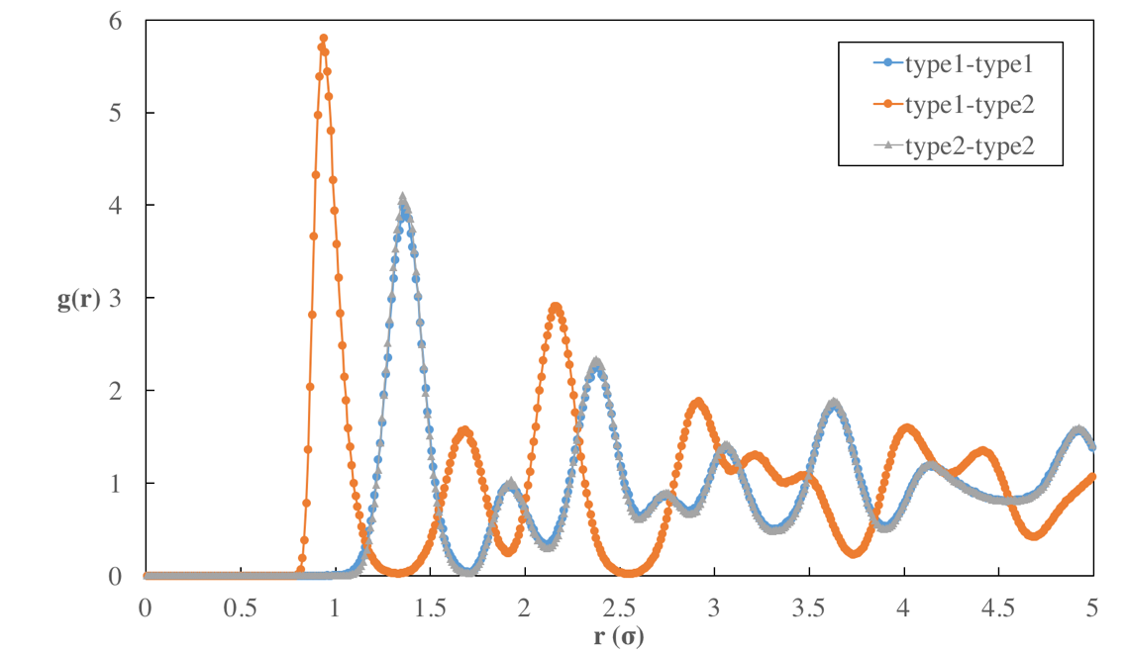
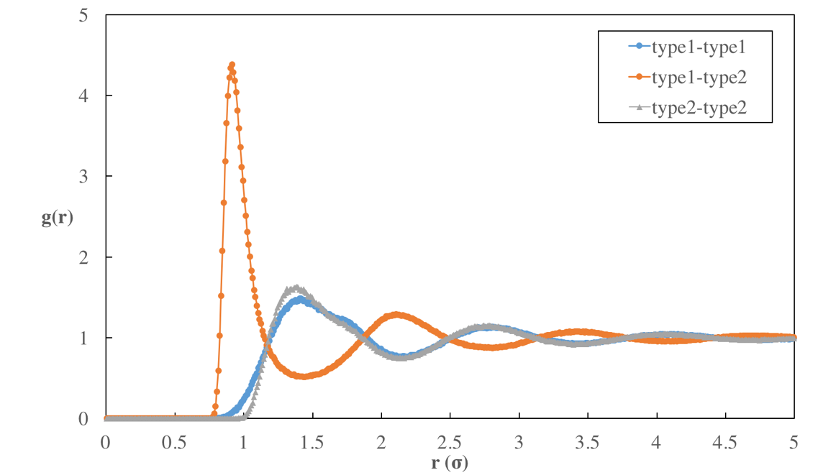
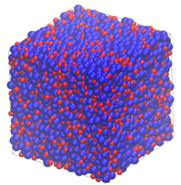
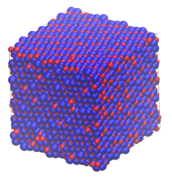
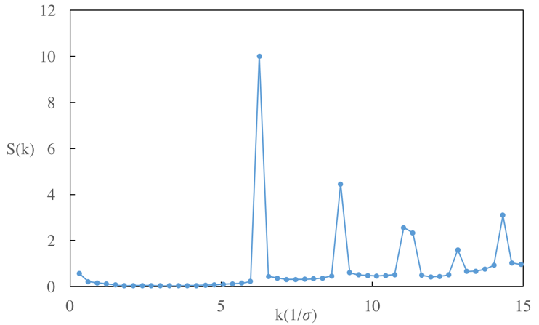
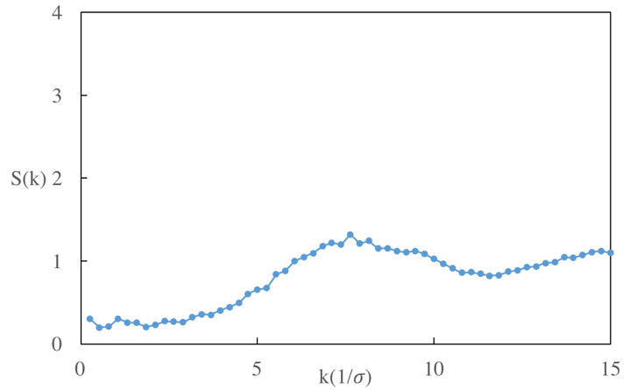
S(k) and g(r) example: ionic liquid
Simple ionic liquid of cations and anions, slightly different cation, anion sizes
Low T High T

Slide 24
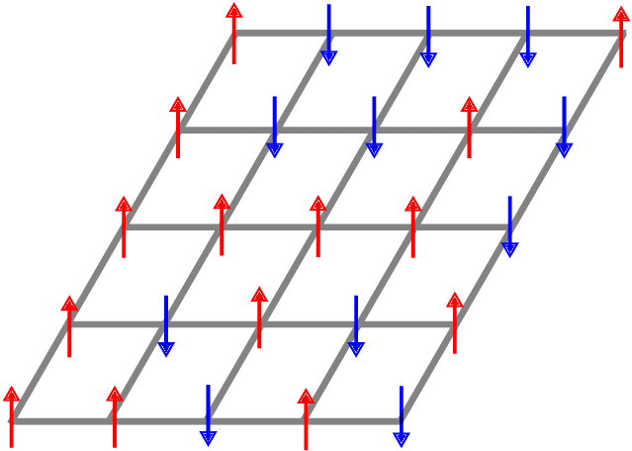
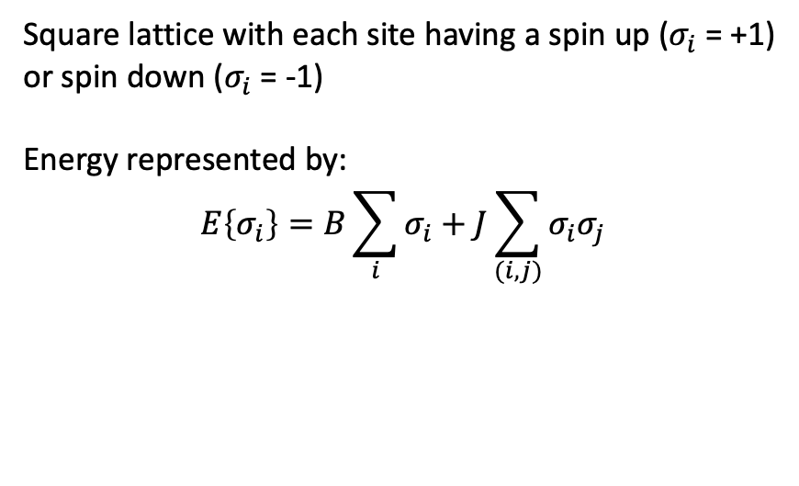
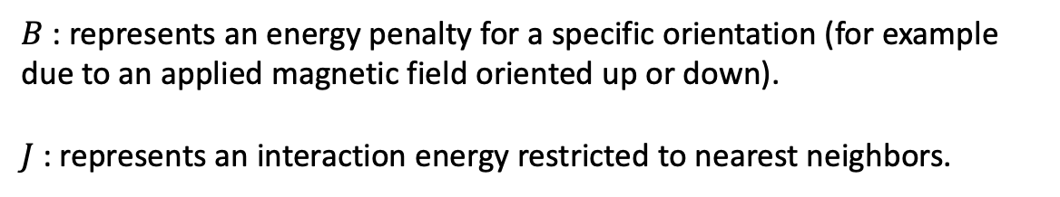
2D Ising Model
Ising model is a toy model first introduced to study magnetization in materials. Specifically, to understand phase transition between ferromagnetic/antiferromagetic and paramagnetic states (the Curie temperature)
Analytically solved for 1D case in 1924 by Ernst Ising. Showed that 1D case does not capture phase transitions.
Analytical solution to 2D case solved in 1944 by Lars Onsager for no external applied field.
2D Ising model phase transitions can be modeled using canonical Monte Carlo with the Metropolis algorithm.
Square lattice with each site having a spin up ($σ_{i}$= +1) or spin down ($σ_{i}$= -1)
Energy represented by:
$$E\left\{σ_{i}\right\}=B\sum_{i}{σ_{i}}+J\sum_{(i,j)}{σ_{i}σ_{j}}$$
$B$: represents an energy penalty for a specific orientation (for example due to an applied magnetic field oriented up or down).
$J$ : represents an interaction energy restricted to nearest neighbors.

Slide 25
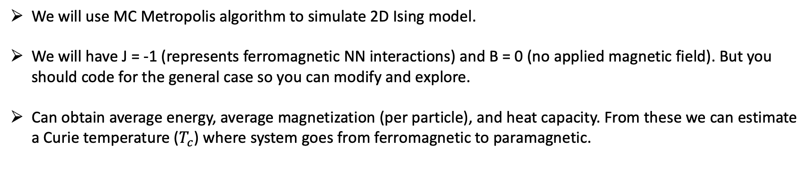
2D Ising Model
We will use MC Metropolis algorithm to simulate 2D Ising model.
We will have J = -1 (represents ferromagnetic NN interactions) and B = 0 (no applied magnetic field). But you should code for the general case so you can modify and explore.
Can obtain average energy, average magnetization (per particle), and heat capacity. From these we can estimate a Curie temperature ($T_{c}$) where system goes from ferromagnetic to paramagnetic.
Onsager’s analytical solutions (B = 0) $T_{c}=2.269J/k_{B}$
You are welcome to use resources on the web, but your own code must reflect your understanding. It is ok to use codes as a model; however, you should not simply submit someone else’s code. Your code should also have clear comments (cite any resources you use in the comments).

